Slide 1
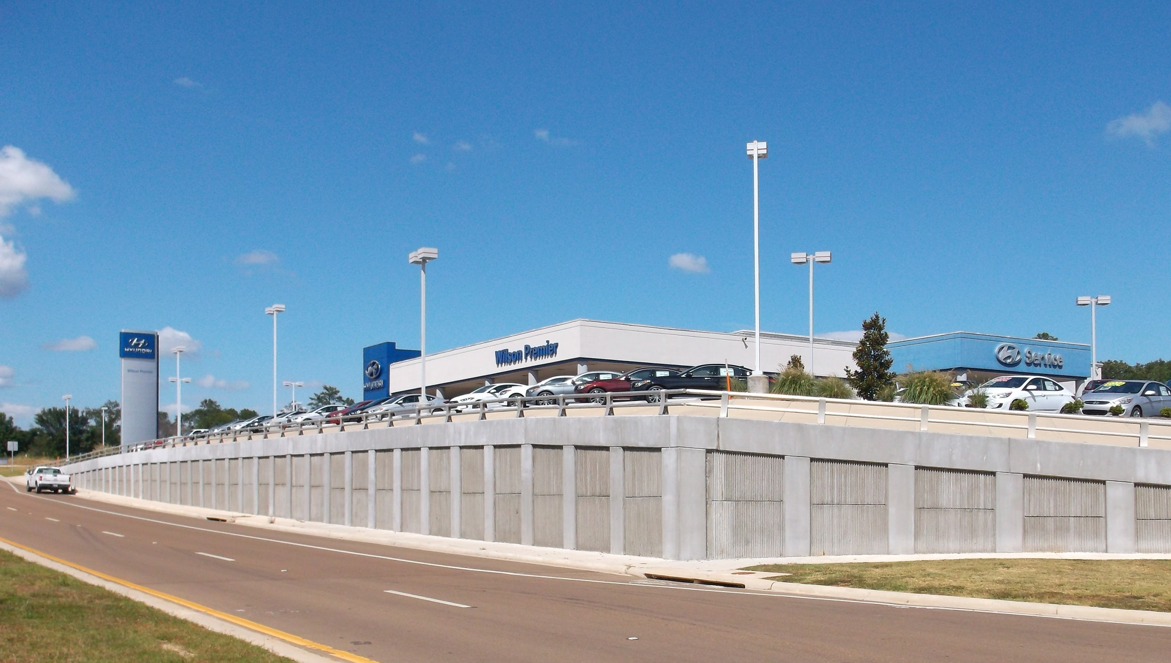
Monitoring of Retaining Wall Lateral Earth Pressures Within High Plasticity, Expansive (Yazoo) Clay

Slide 2
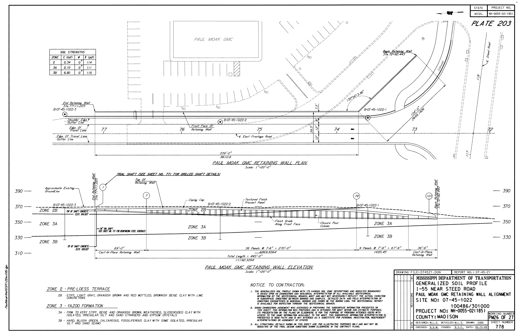
SITE PLAN AND GENERALIZED SOIL PROFILE

Slide 3
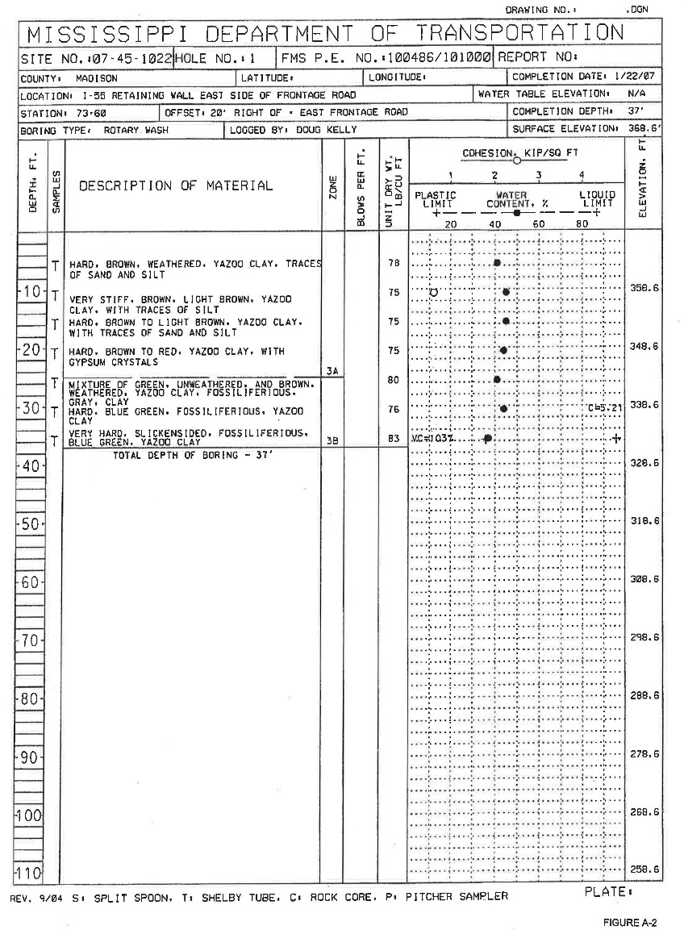
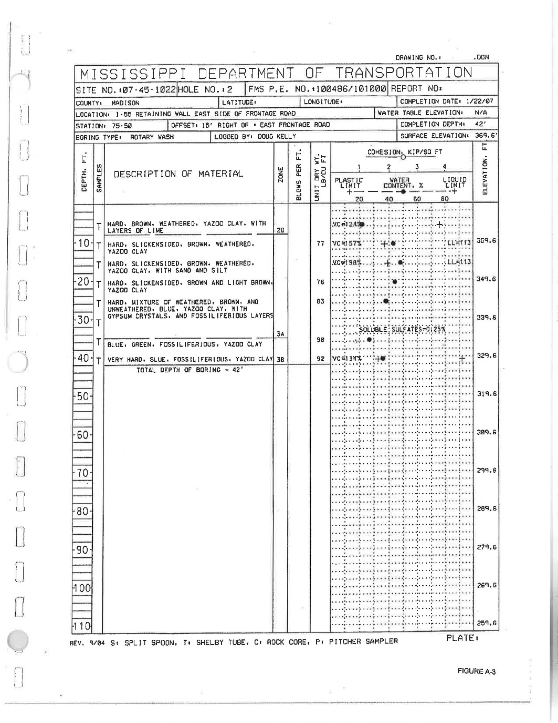
RETAINING WALL BORING LOGS
BORING B-1
BORING B-2

Slide 4
TYPICAL RETAINING WALL BORING

Slide 5
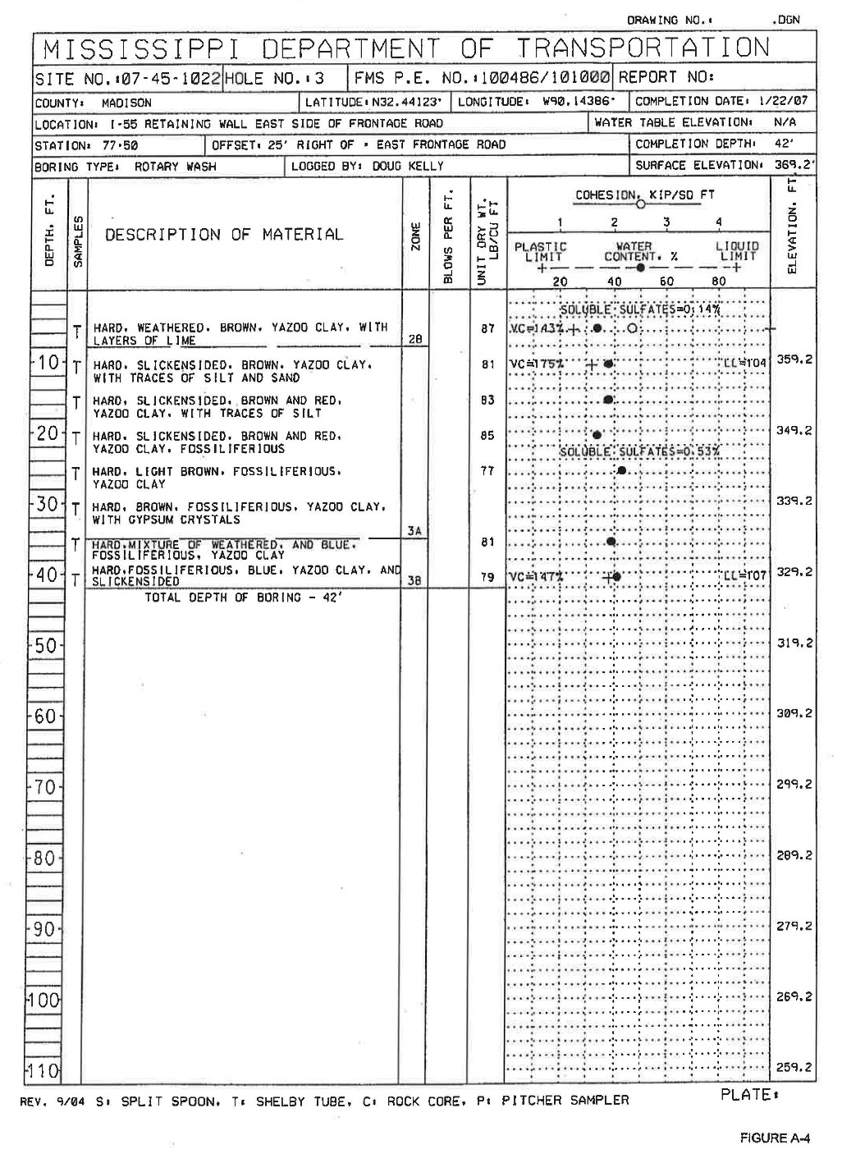
RETAINING WALL BORING LOGS
SUMMARY SOIL PROPERTIES
WEATHERED YAZOO CLAY
Ɣ = 111 PCF
C = 2,100 PSF
ᶲ = 0°
WATER CONTENT – 33% TO 48%
LIQUID LIMIT – 100% TO 113%
PI – 72% TO 75%
UNWEATHERED YAZOO CLAY
Ɣ = 114 PCF
C = 6,600 PSF
ᶲ = 0°
WATER CONTENT - 28% TO 44%
LIQUID LIMIT – 92% TO 107%
PI – 59% TO 69%
BORING B-3

Slide 6
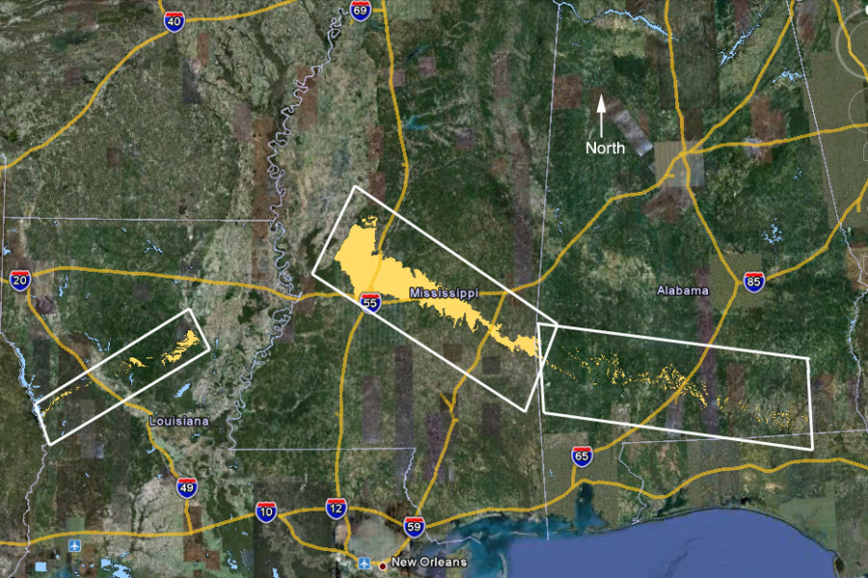
EXTENT OF YAZOO CLAY WITHIN THREE STATE AREA
Ref.: Lee Jr., Landis T., “State Study 151 and 236: Yazoo Clay
Investigation; USACE ERDC; June 2012.

Slide 7
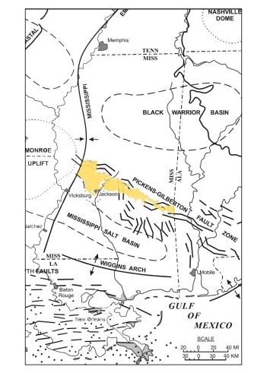
ASSUMED TO ORIGINATE IN THE EOCENE ERA
JACKSON GROUP, YAZOO FORMATION
JACKSON DOME, 25 SQ. MILES
CENTERED APPROX. 2000 FEET BELOW JACKSON
DIPS IN ALL DIRECTIONS FROM DOME
YAZOO CLAY OUTCROPS IN 6 COUNTIES
IN MISSISSIPPI
Ref.: Lee Jr., Landis T., “State Study 151 and 236: Yazoo Clay
Investigation; USACE ERDC; June 2012.

Slide 8
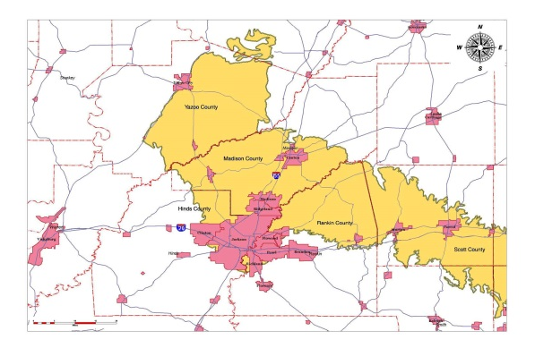
GEOLOGIC VICINITY AND SITE LOCATION
SITE LOCATION
Ref.: Lee Jr., Landis T., “State Study 151 and 236: Yazoo Clay
Investigation; USACE ERDC; June 2012.

Slide 9
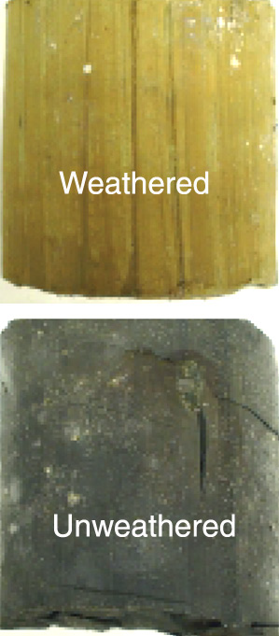
YAZOO CLAY
BEIGE, YELLOWISH ORANGE (OXIDIZED/WEATHERED), HIGH PLASTICITY, MONTMORILLIC CLAY (CH); CAN BE CALCAREOUS AND CONTAIN GYPSUM
BLUE-GRAY, UNWEATHERED, CALCAREOUS, FOSSILIFEROUS, SLIGHTLY SILTY, HIGH PLASTICITY, MONTMORILLIC CLAY (CH); TRACE THIN LIMESTONES AND BENTOTONIC CLAY

Slide 10
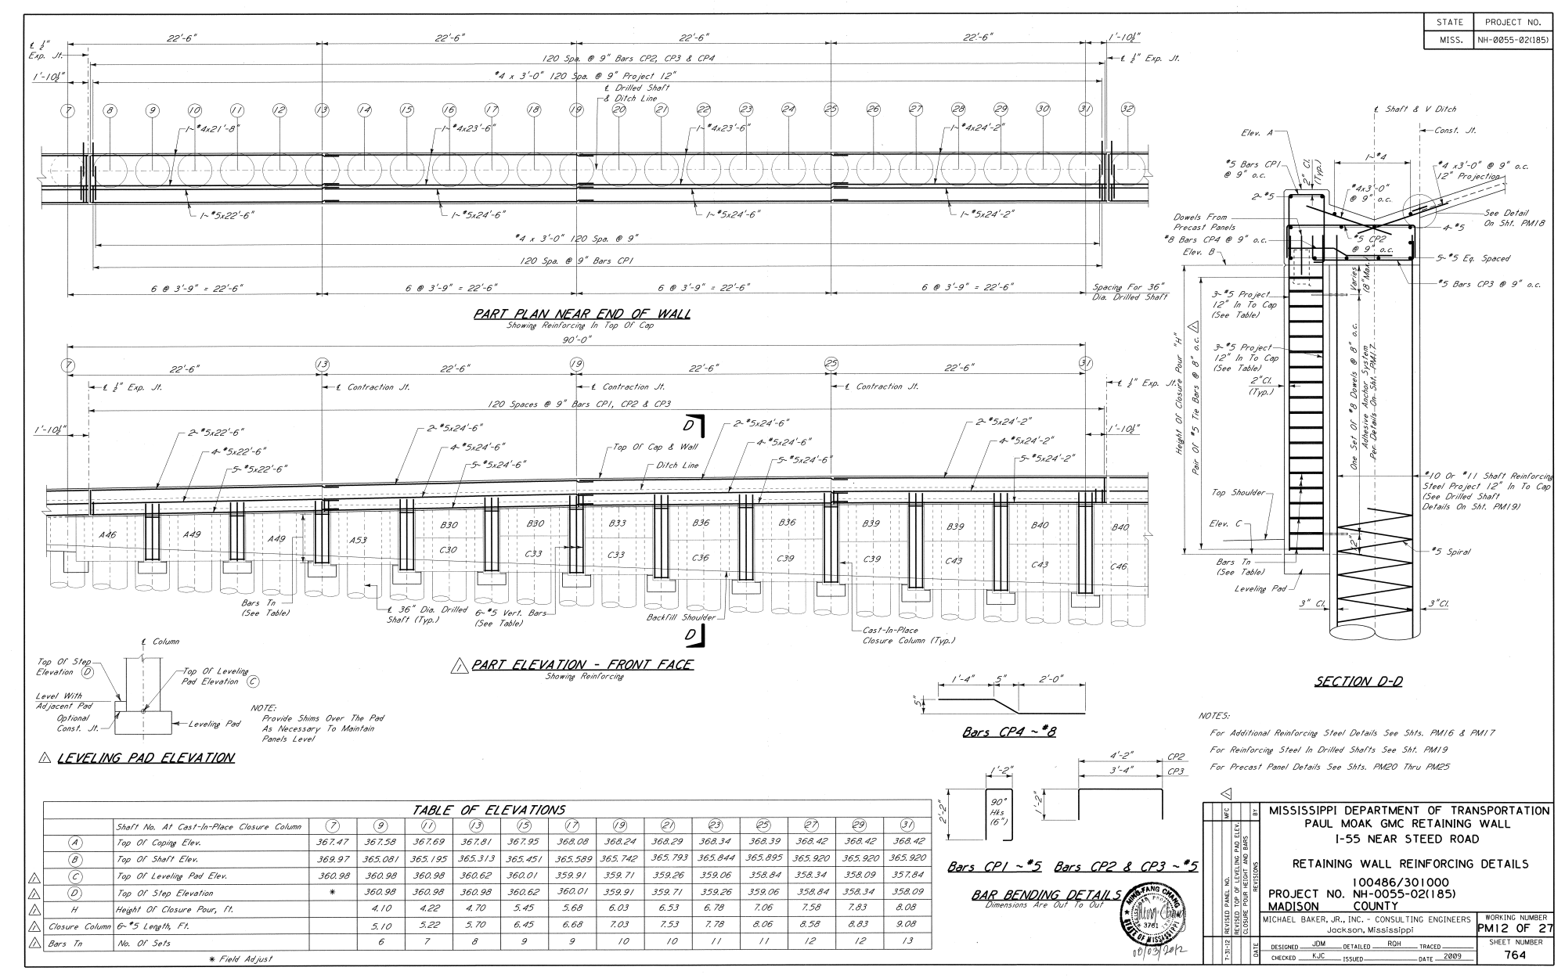
CONSTRUCTION PLAN, PROFILE & SECTION

Slide 11
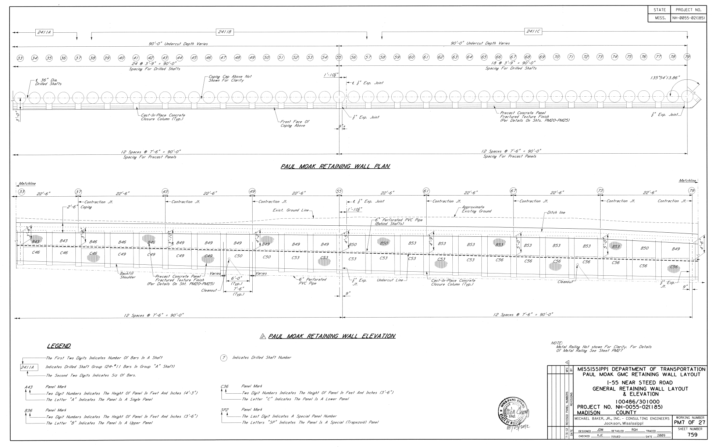
SHAFTS 62, 64 AND 76

Slide 12
DESIGN LATERAL EARTH PRESSURES
DESIGN LATERAL EARTH PRESSURES IN HIGHLY PLASTIC, EXPANSIVE, WEATHERED YAZZO CLAY CONSIDERING SWELLING POTENITAL OF THESE SOILS.
DR. LYTTON’S EXPANSIVE LATERAL EARTH PRESSURE THEORY USED TO ESTIMATE LATERAL EARTH PRESSURES IN THE SOIL IN THE UPPER FIVE FEET.
ZONE 1 (0 FEET TO 5 FEET) – MAXIMUM LATERAL EARTH PRESSURE ESTIMATED TO BE EQUAL TO THE PASSIVE EARTH PRESSURE ASSUMING UNDRAINED SHEAR STRENGTH OF 2,000 PSF.
ZONE 2 (BETWEEN 5 FEET AND 12 FEET) – LATERAL EARTH PRESSURE TO VARY LINEARLY BETWEEN THE BOTTOM OF ZONE 1 AND THE TOP OF ZONE 3.
ZONE 3 (SOIL DEPTH GREATER THAN 12 FEET) – MAXIMUM LATERAL EARTH PRESSURE ESTIMATED TO EQUAL THE AT-REST EARTH PRESSURES.

Slide 13
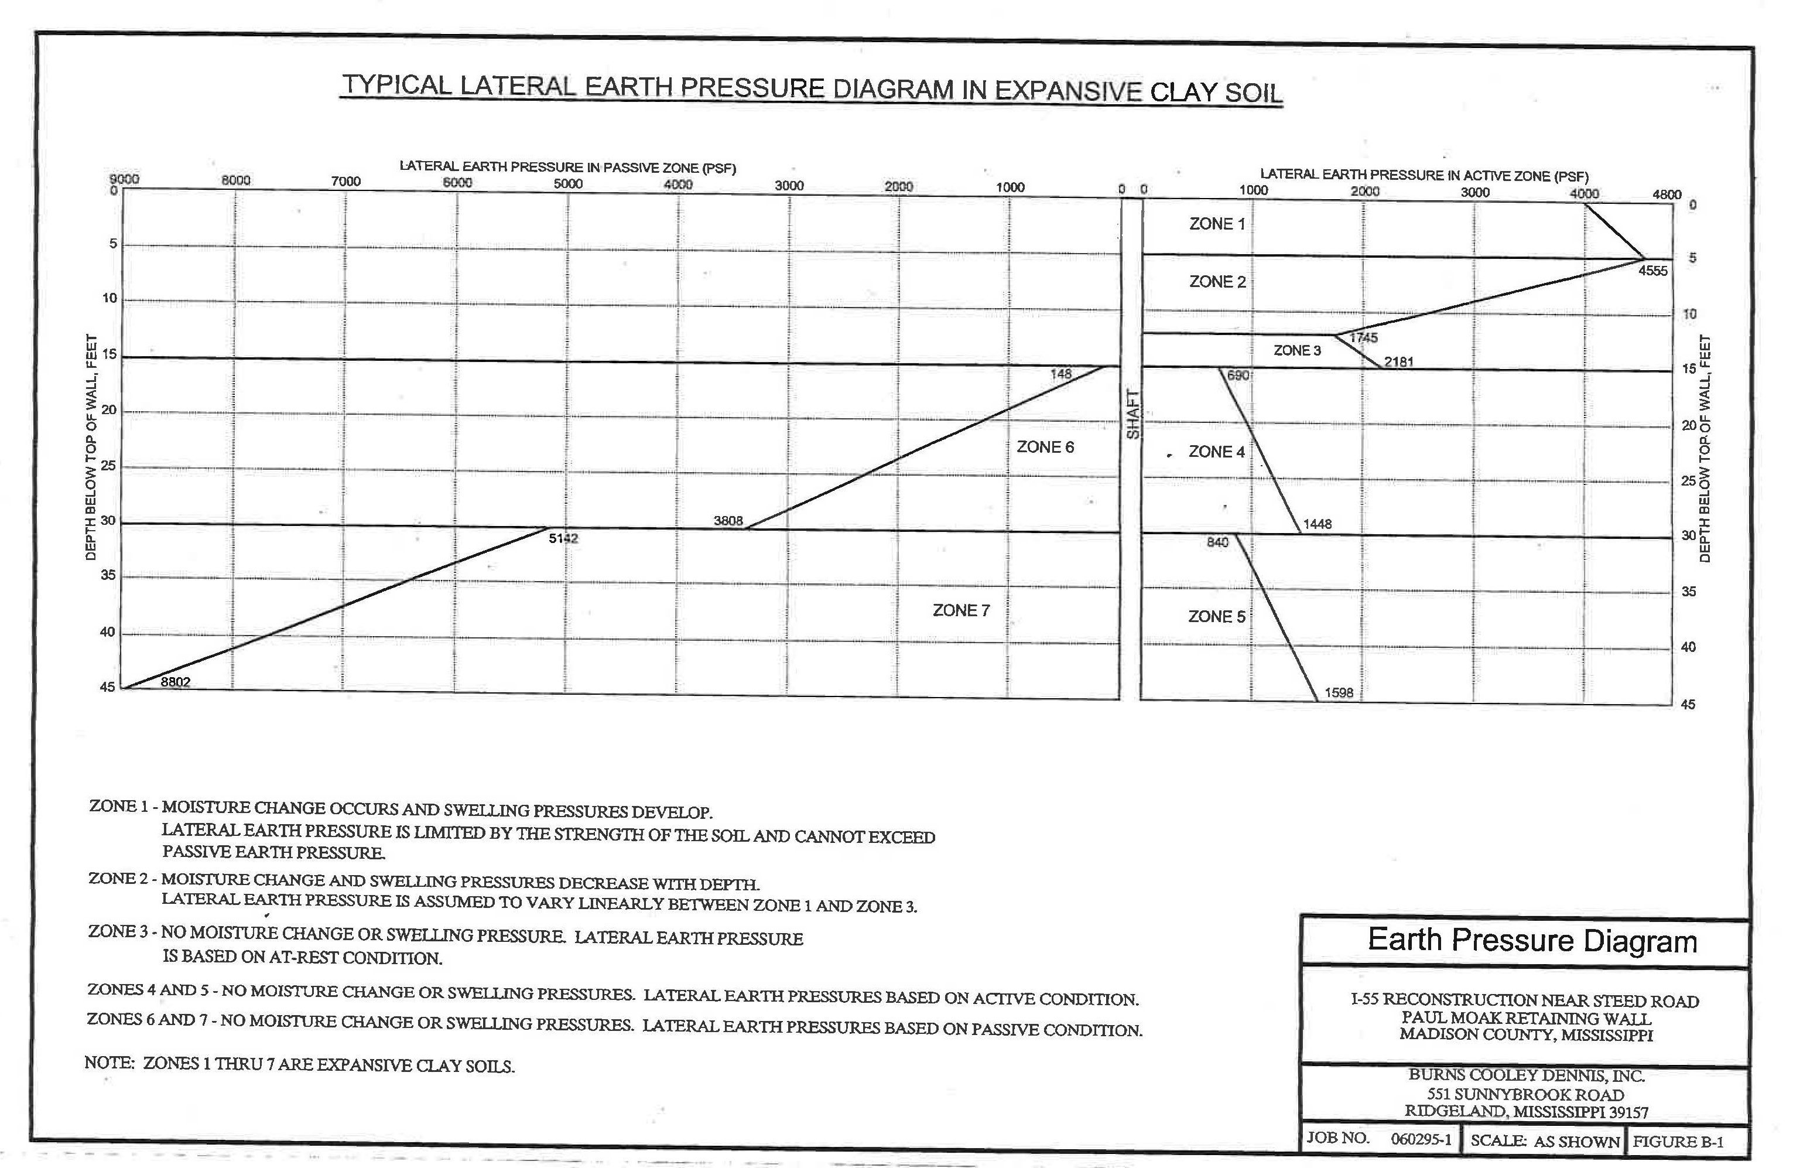
Ref.: Burns Cooley Dennis, Inc., “Geotechnical Investigation, I-55 Reconstruction Near Steed Road, Paul Moak GMC Retaining Wall, Madison County, MS; Report No. 060295-1; June 23, 2008.

Slide 14
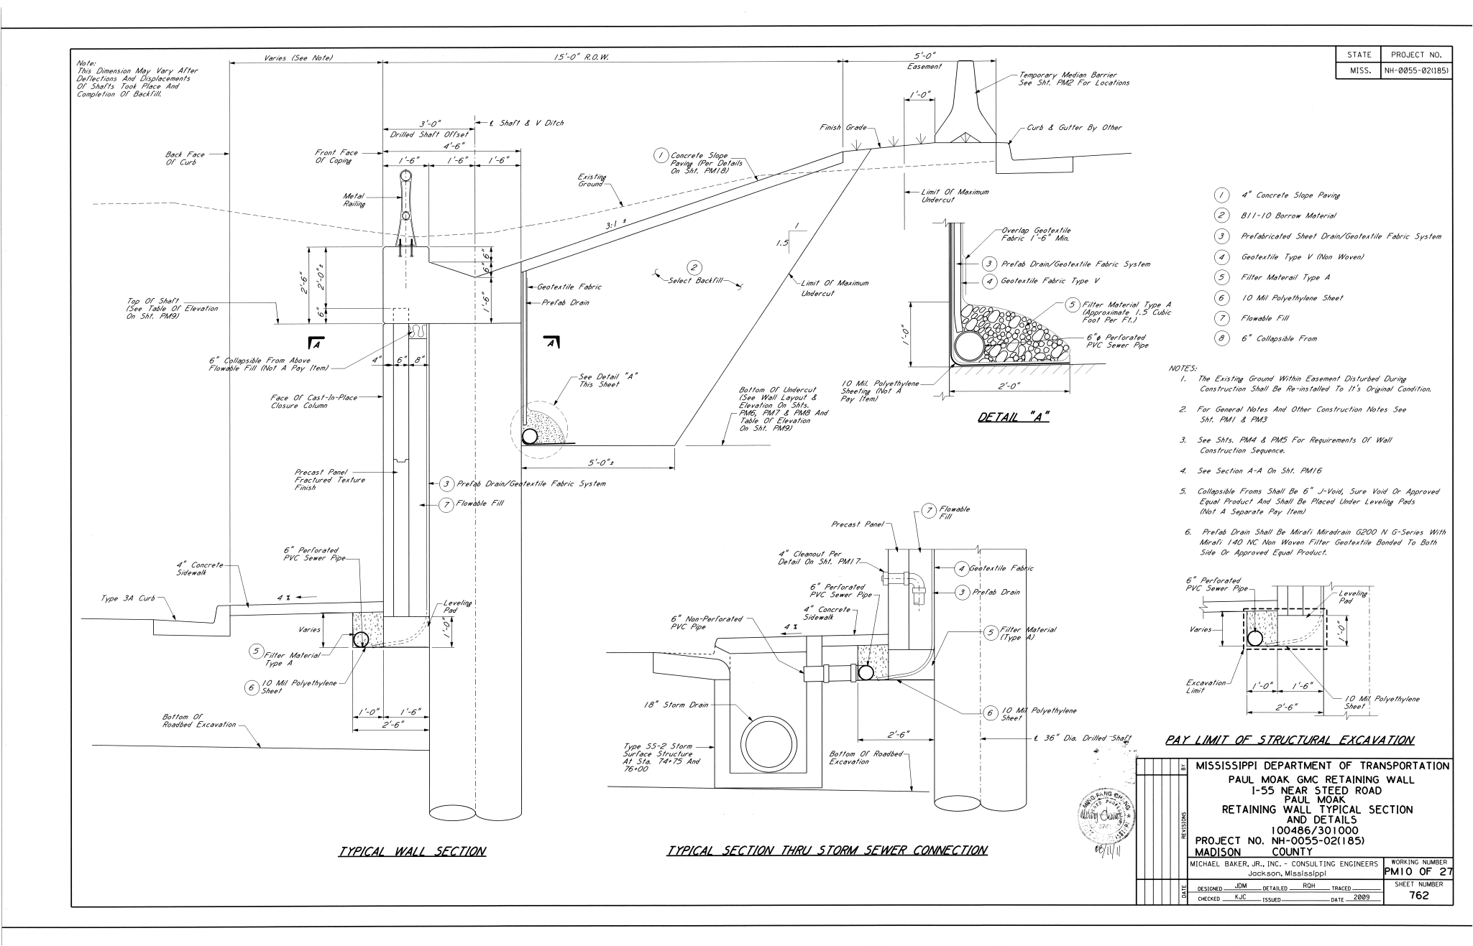
TOP OF WALL MODIFICATIONS

Slide 15
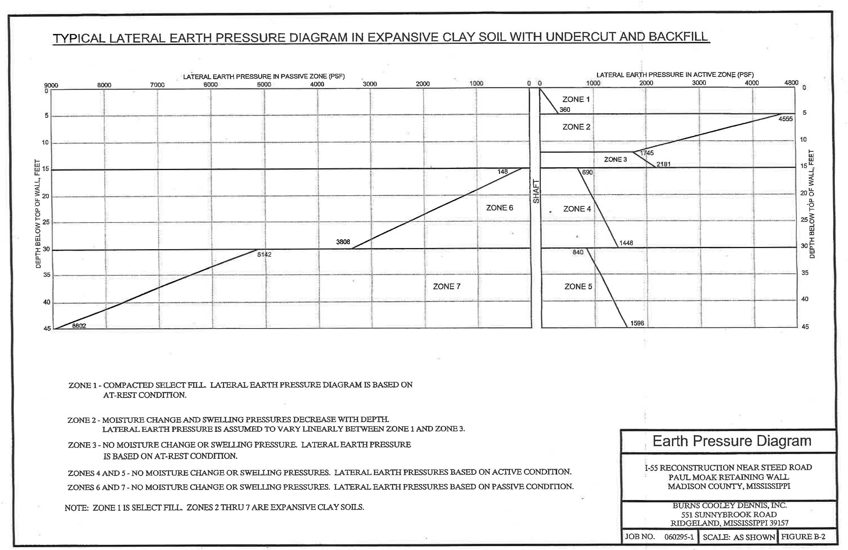
Ref.: Burns Cooley Dennis, Inc., “Geotechnical Investigation, I-55 Reconstruction Near Steed Road, Paul Moak GMC Retaining Wall, Madison County, MS; Report No. 060295-1; June 23, 2008.

Slide 16
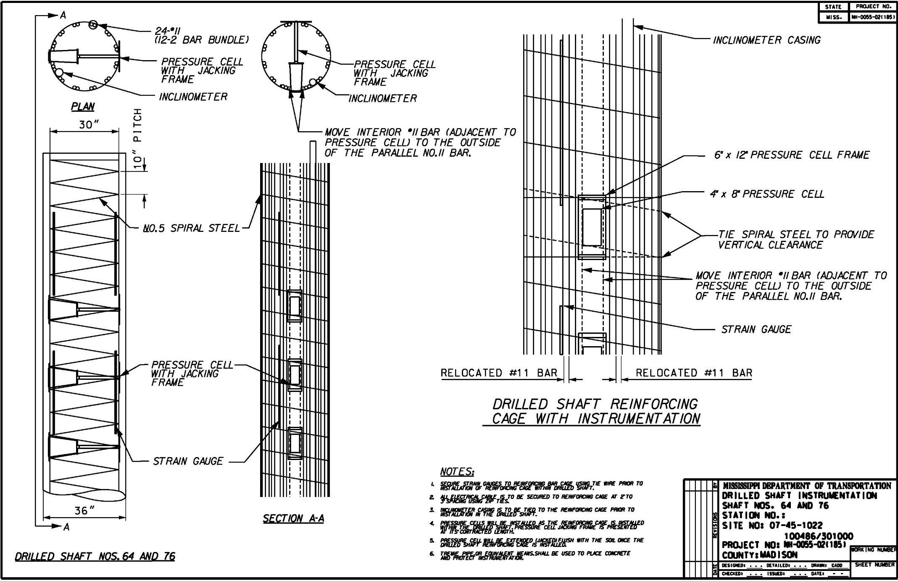
INSTRUMENTATION DIAGRAM

Slide 17
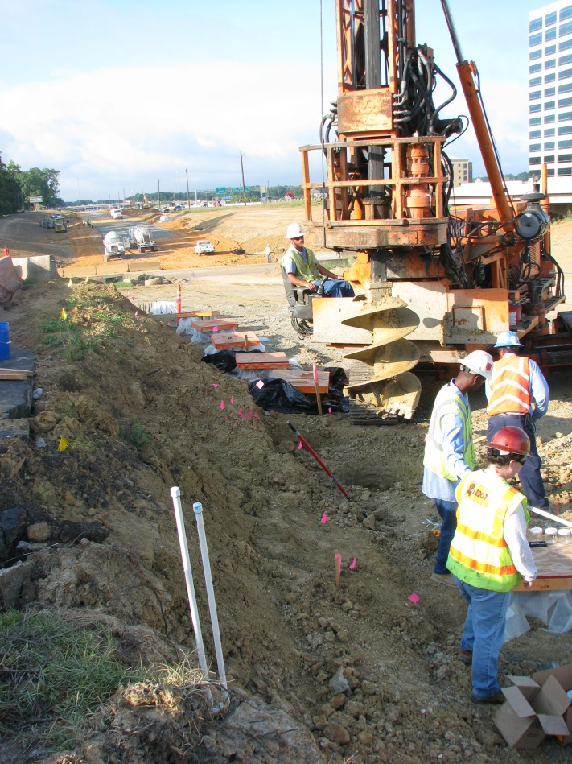
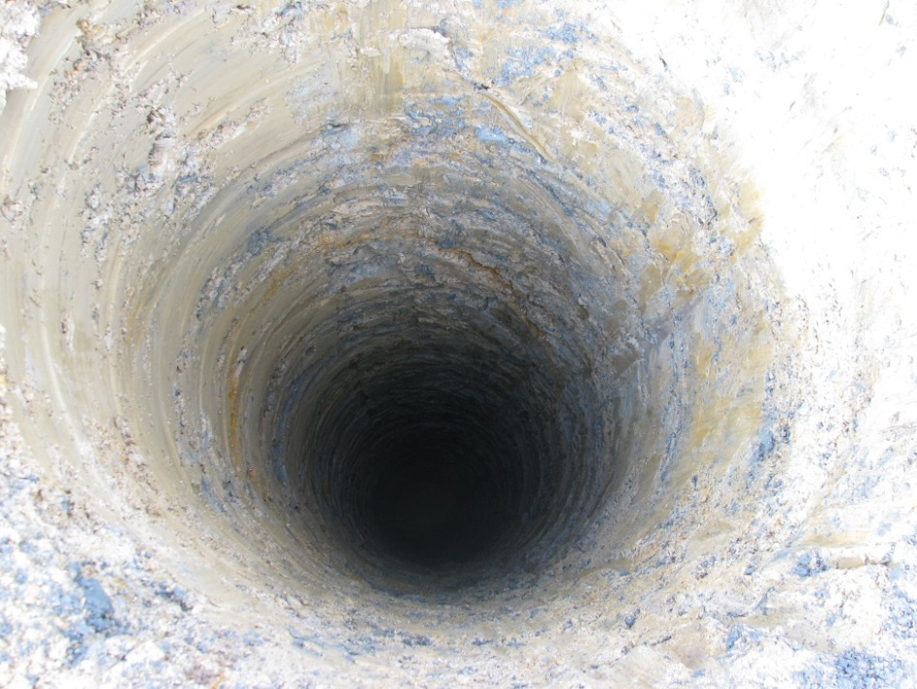
SHAFT 62

Slide 18
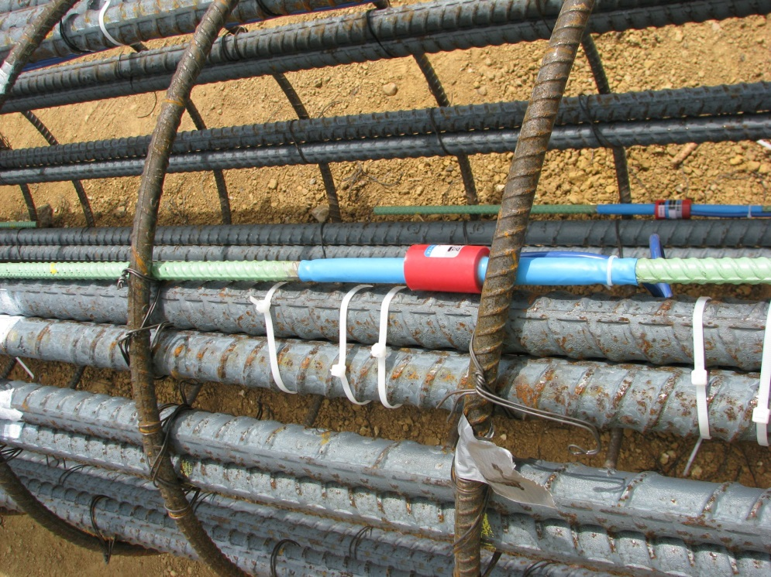
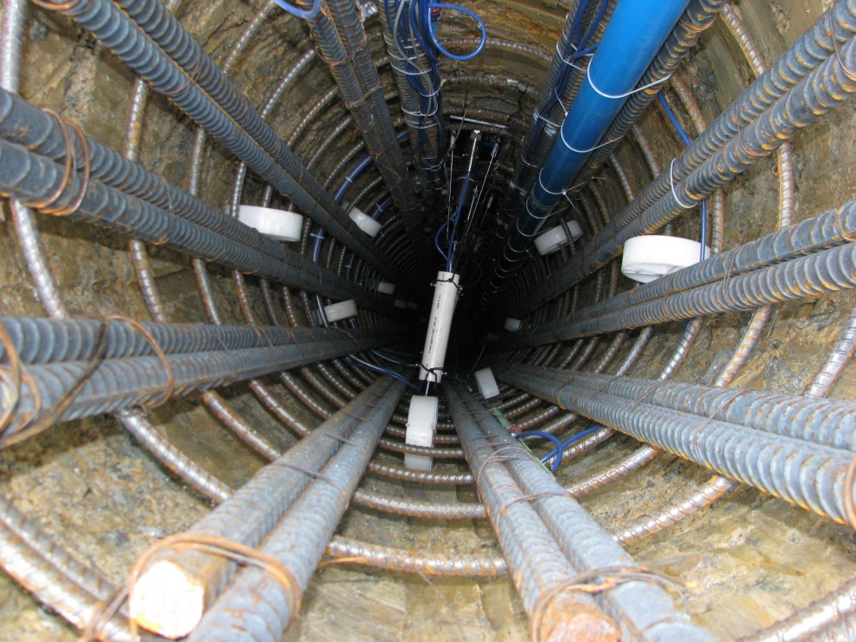
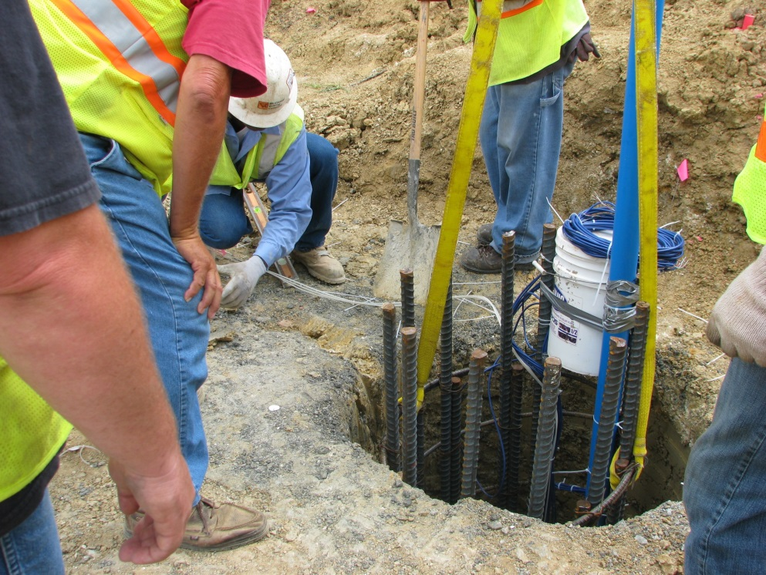
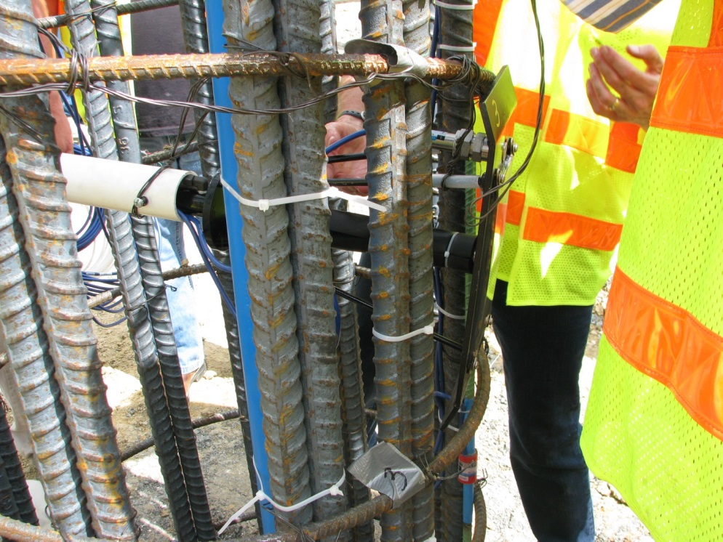
SHAFT 62 CONTINUED

Slide 19
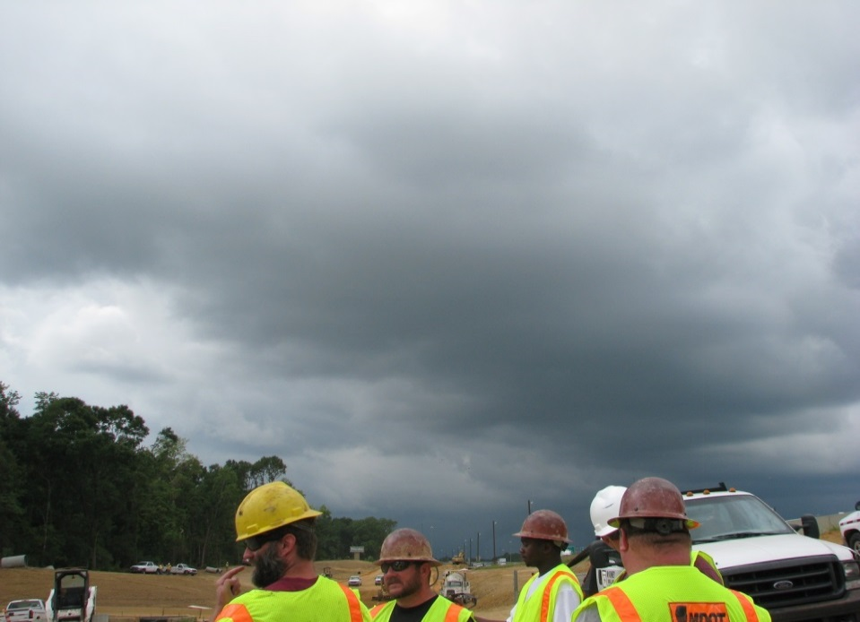
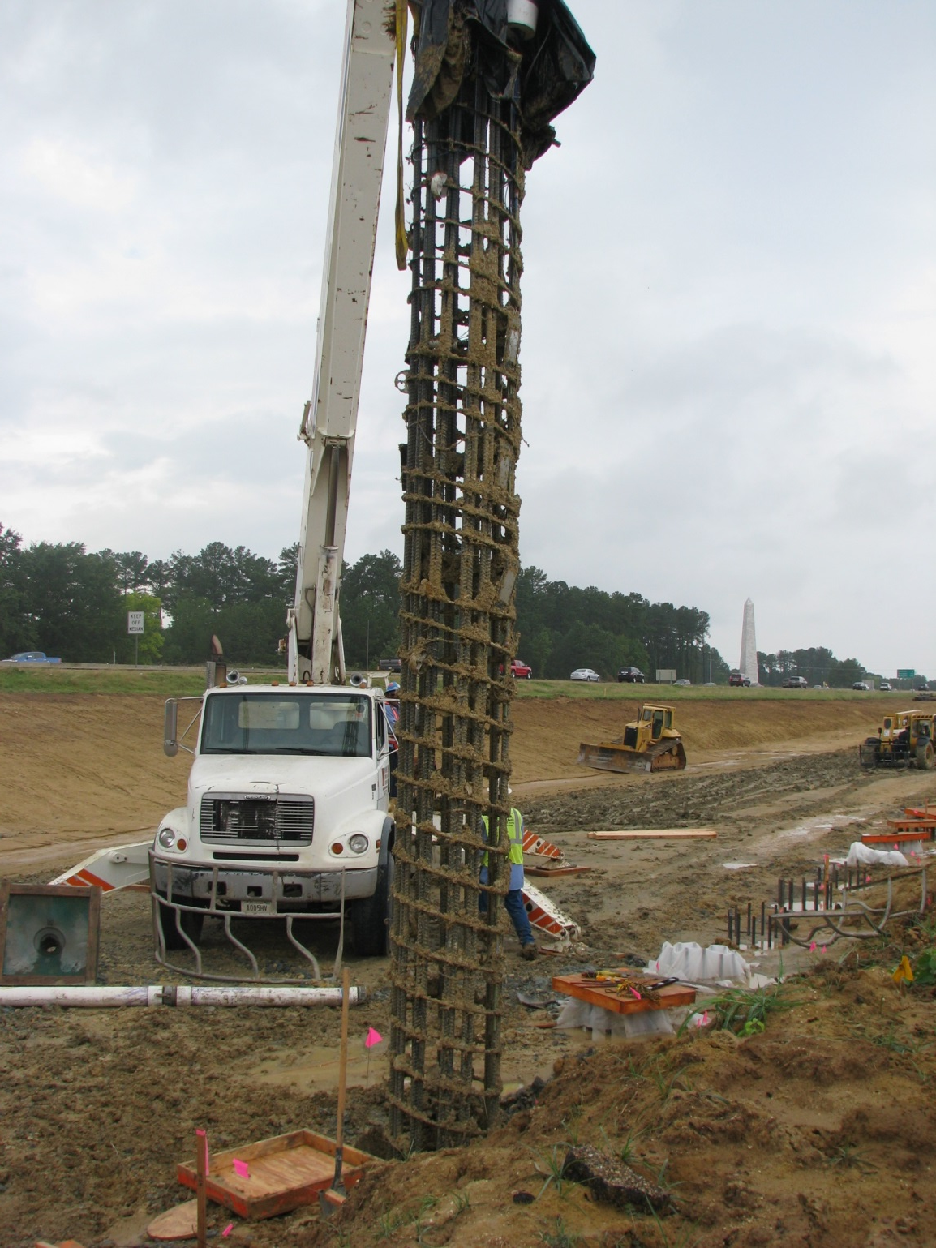
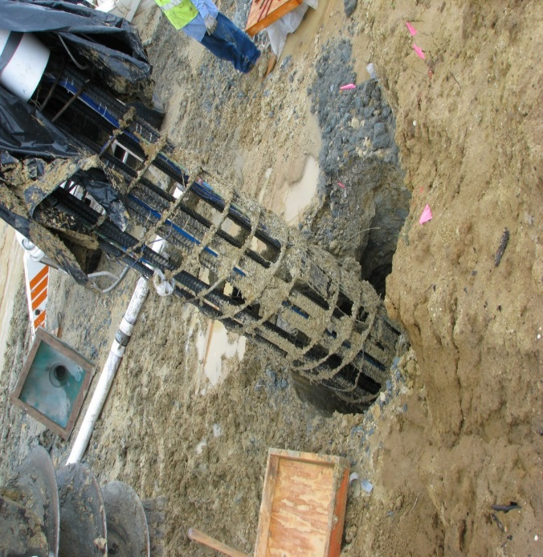
SHAFT 62 ABANDONED

Slide 20
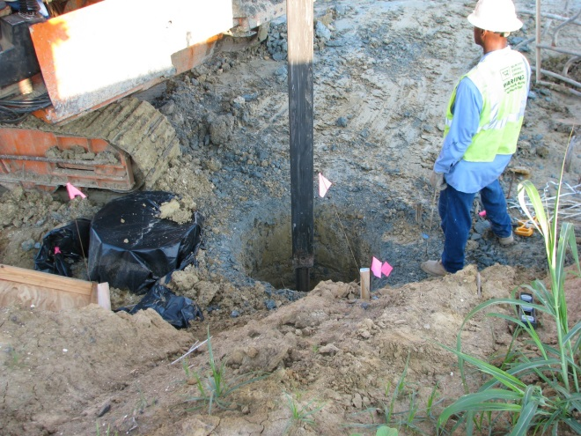
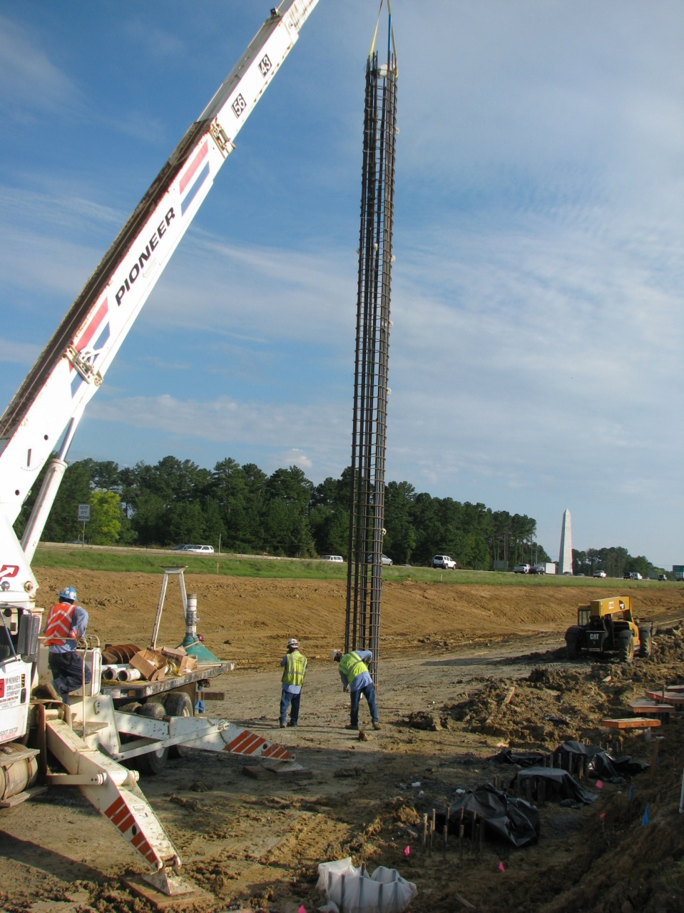
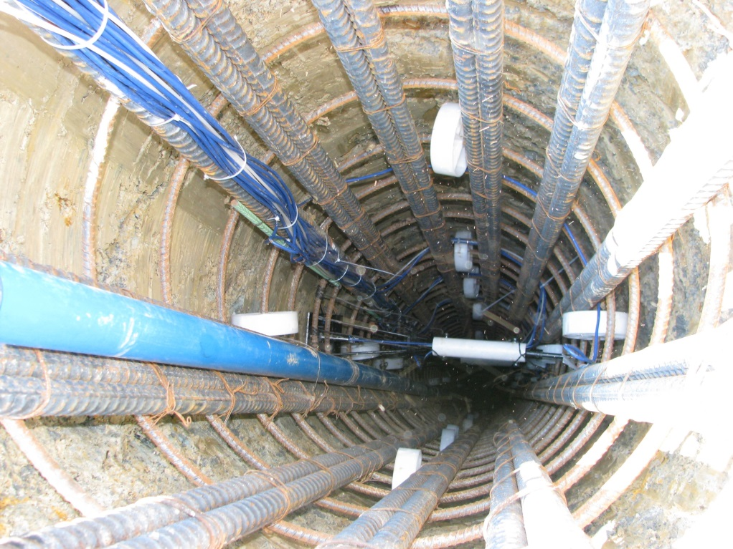
SHAFT 64

Slide 21
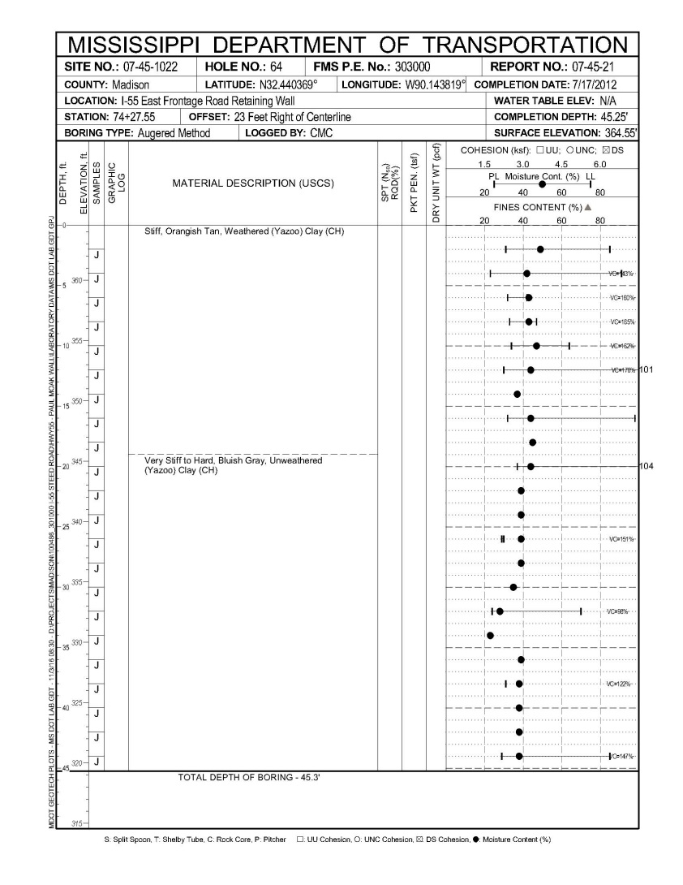
SHAFT 64
WEATHERED YAZOO CLAY
WATER CONTENT = 44%
PI = 60%
LIQUID LIMIT = 91%
VOLUME CHANGE = 163%
UNWEATHERED YAZOO CLAY
WATER CONTENT = 36%
PI = 51%
LIQUID LIMIT = 78%
VOLUME CHANGE = 130%

Slide 22
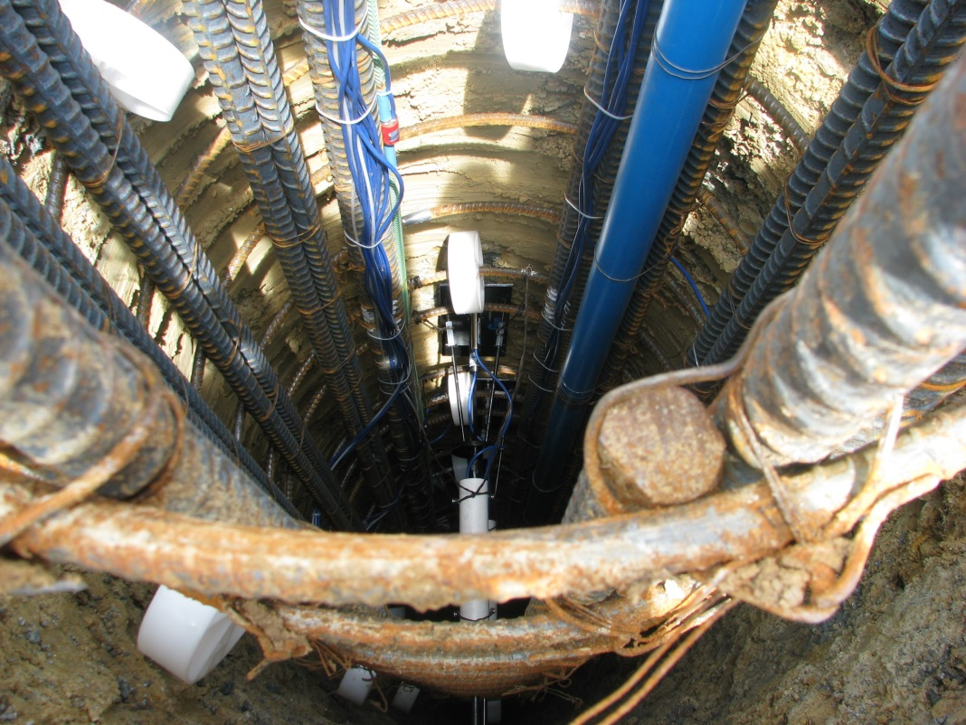
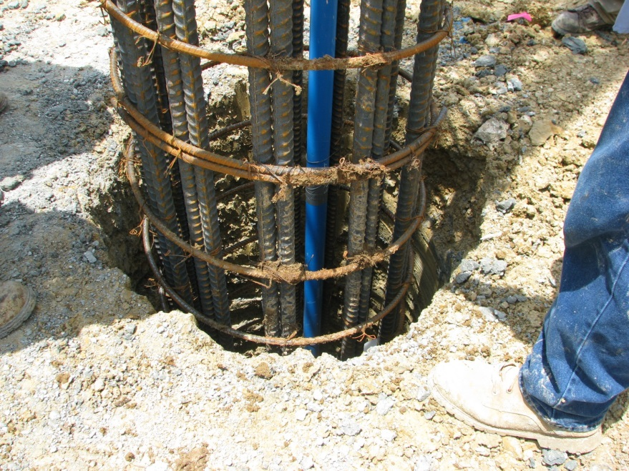
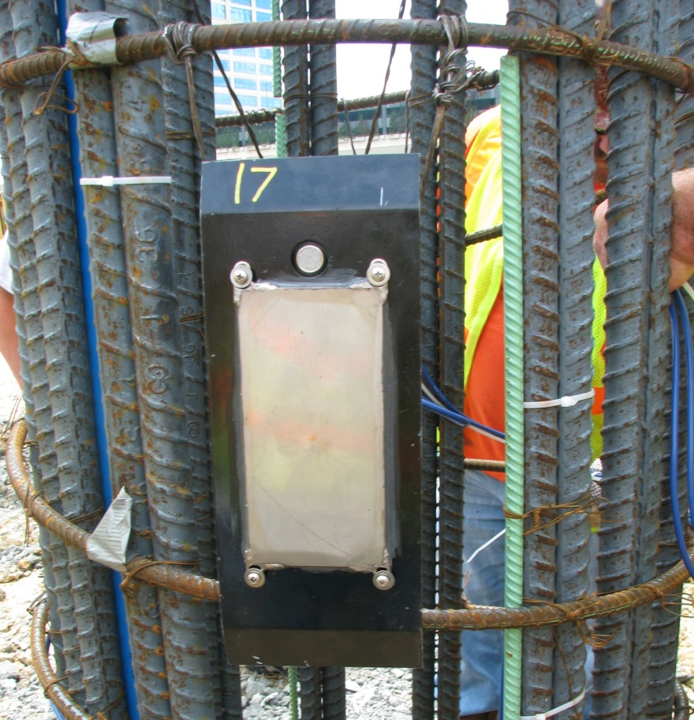
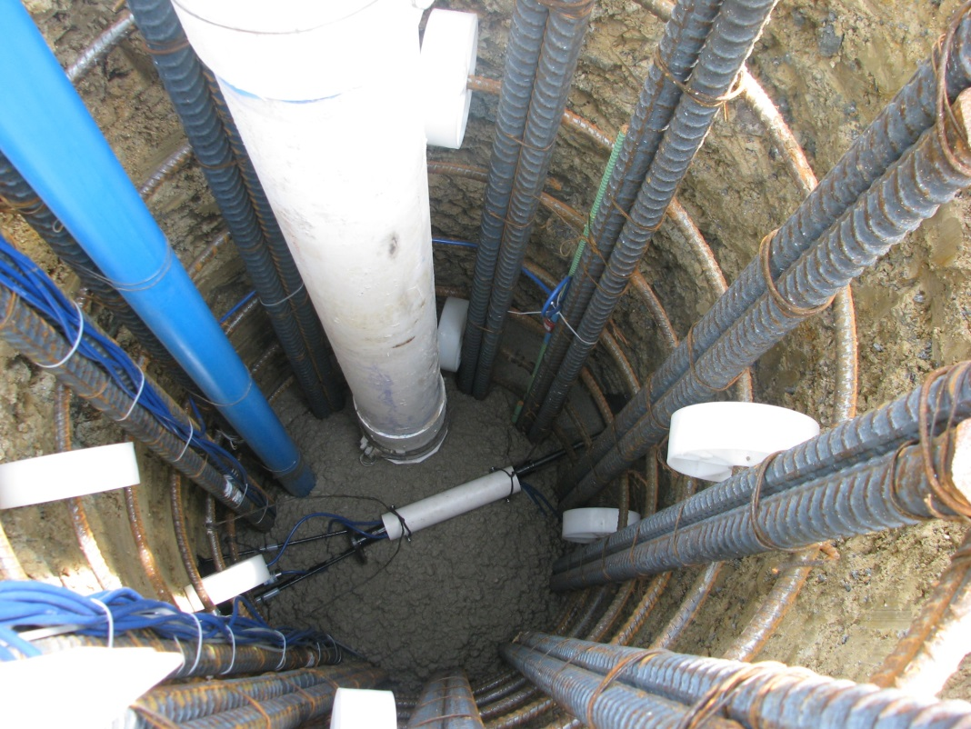
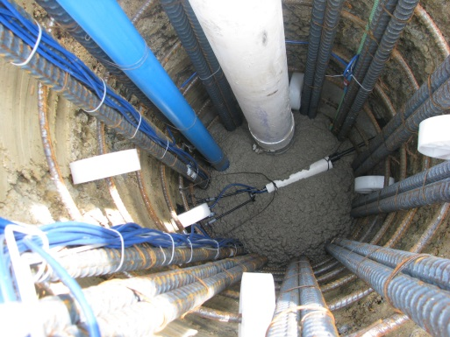
SHAFT 76

Slide 23
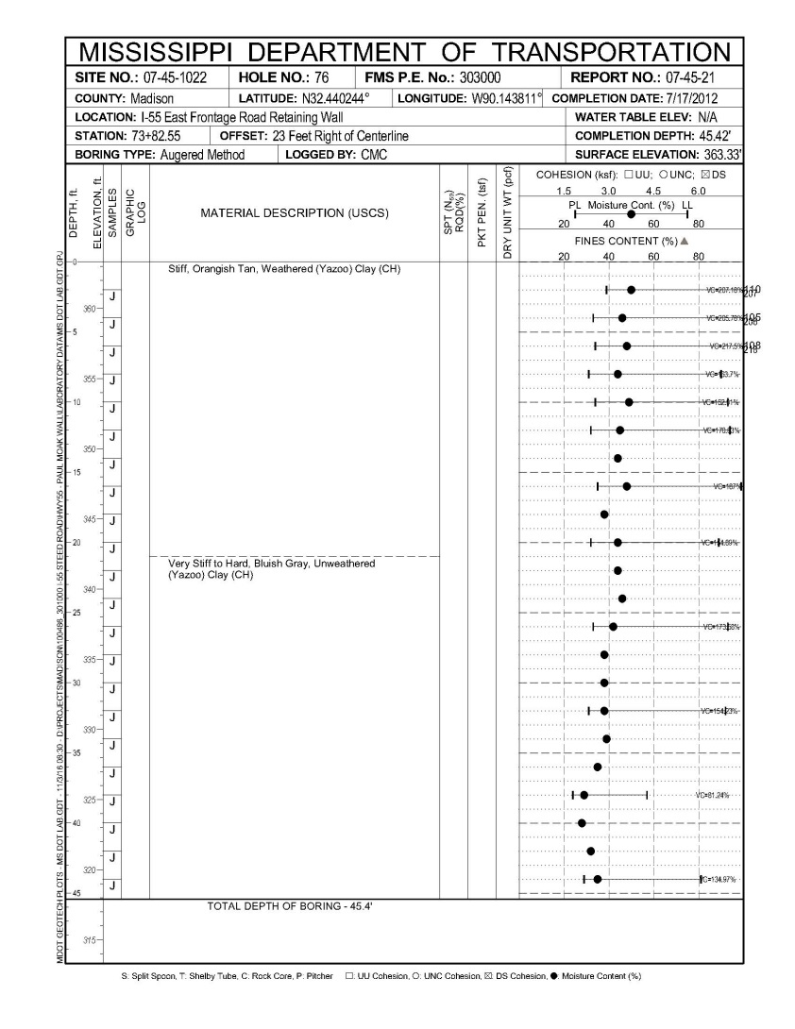
SHAFT 76
WEATHERED YAZOO CLAY
WATER CONTENT = 46%
PI = 65%
LIQUID LIMIT = 99%
VOLUME CHANGE = 184%
UNWEATHERED YAZOO CLAY
WATER CONTENT =40%
PI = 52%
LIQUID LIMIT =81%
VOLUME CHANGE = 136%

Slide 24
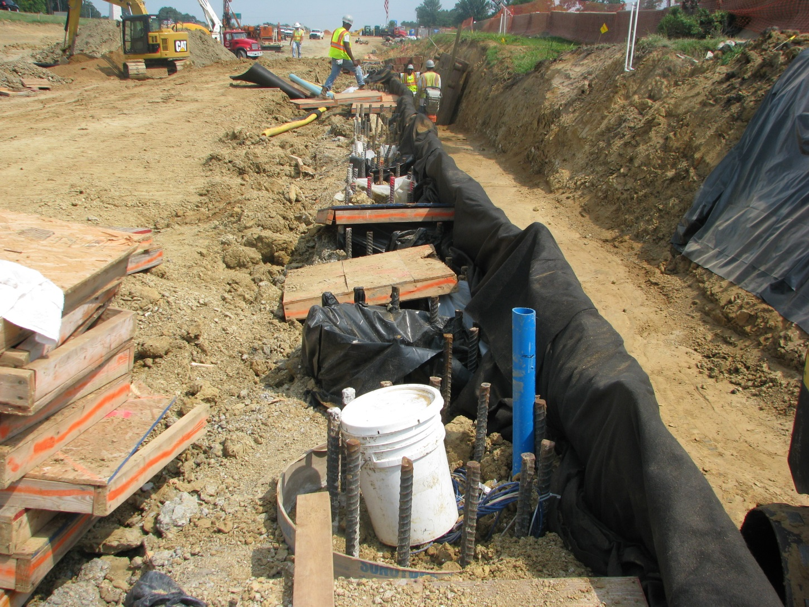
BASELINE READINGS AND SOIL BACKFILL
(AUG. 15, 2102)

Slide 25
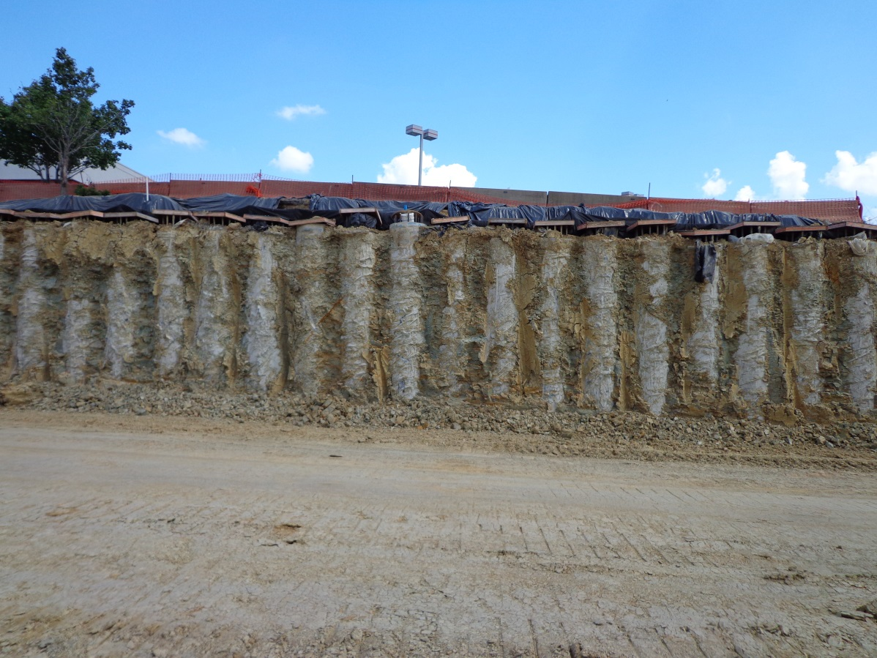
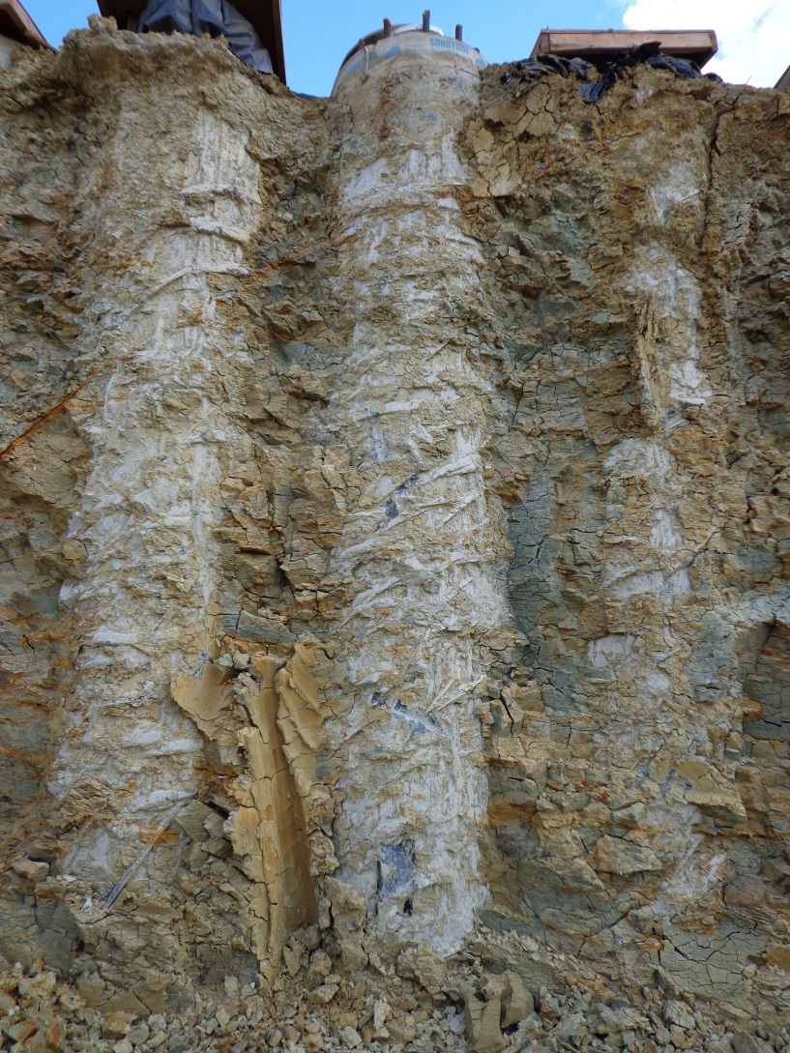
SHAFT EXCAVATION (Sept. 12, 2012)
SHAFT 64
SHAFT 64

Slide 26
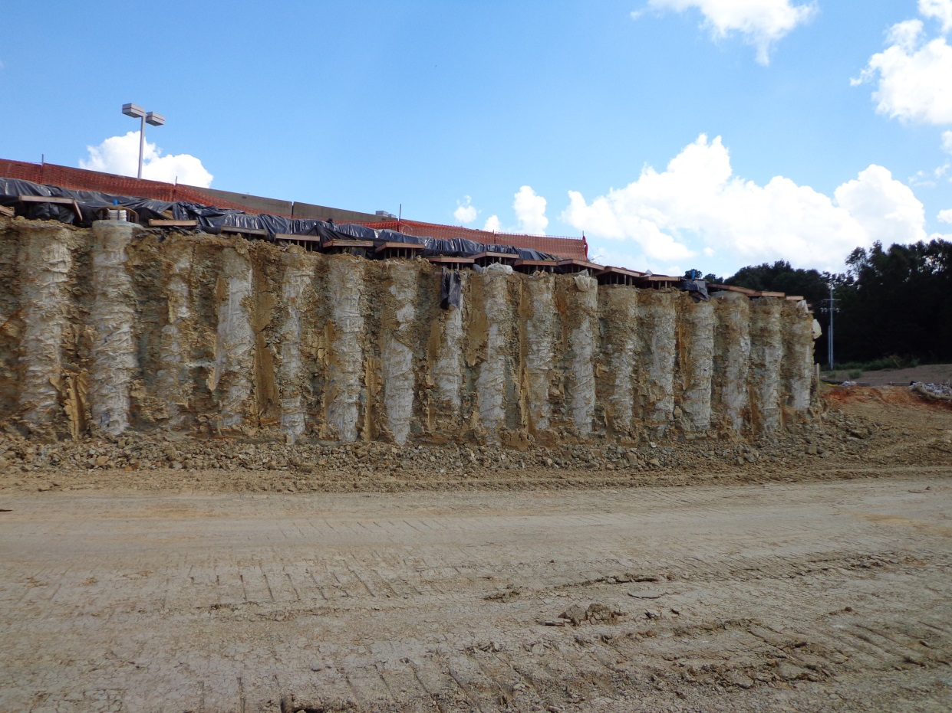
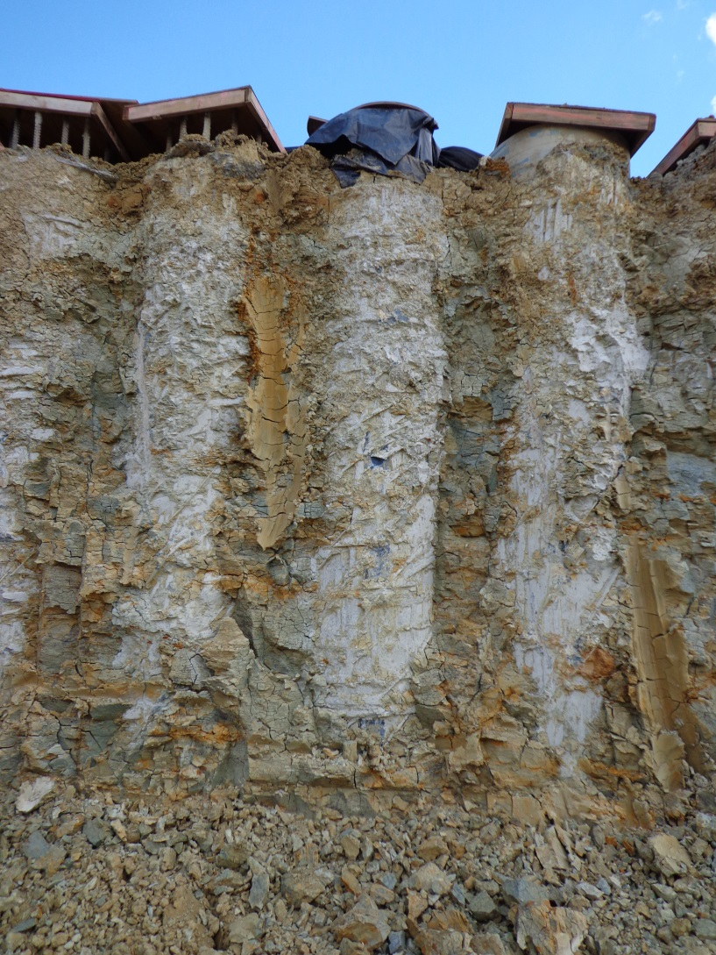
SHAFT EXCAVATION (Sept. 12, 2012)
SHAFT 64
SHAFT 76
SHAFT 76

Slide 27
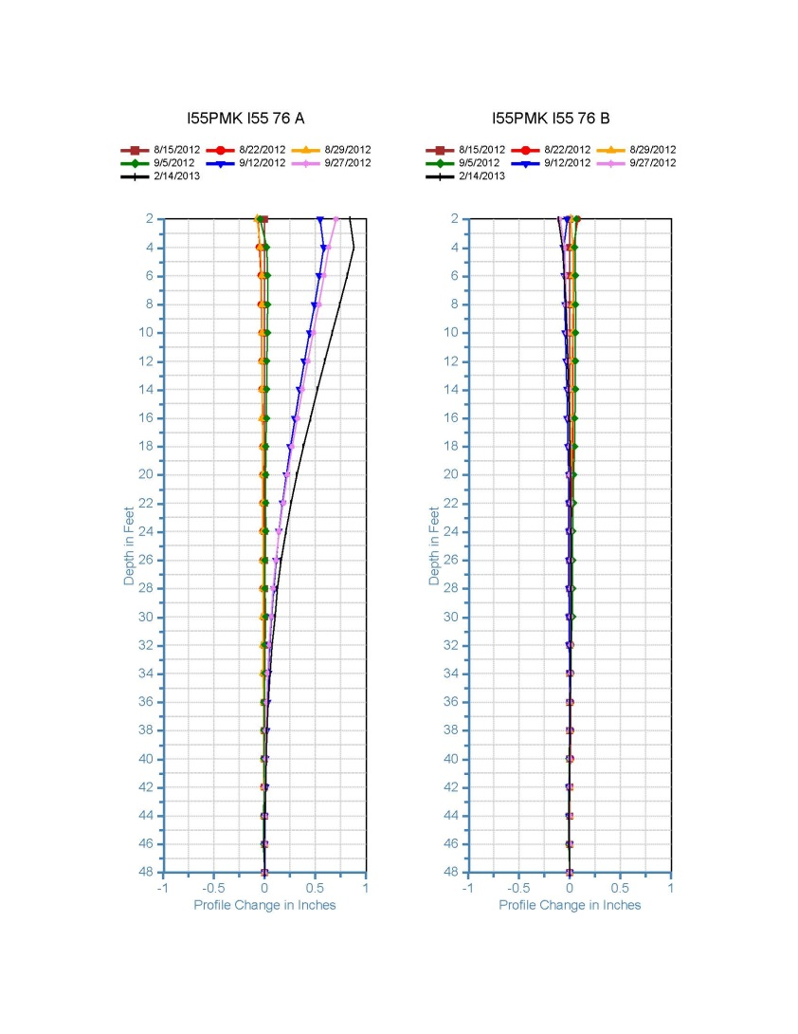
Shaft 76 Inclinometer

Slide 28
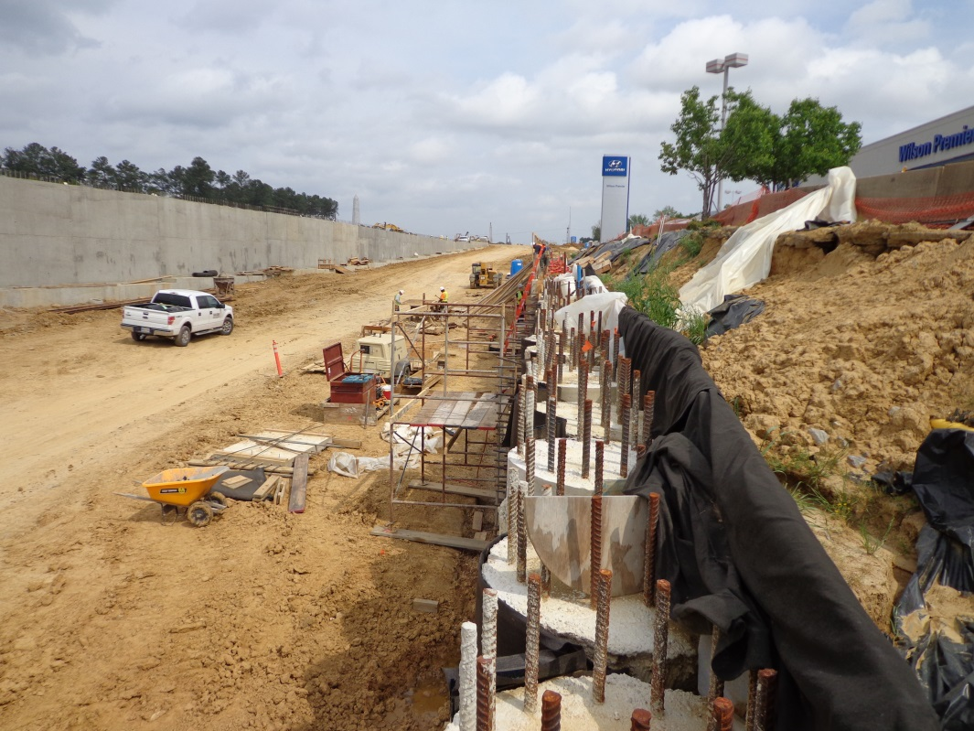
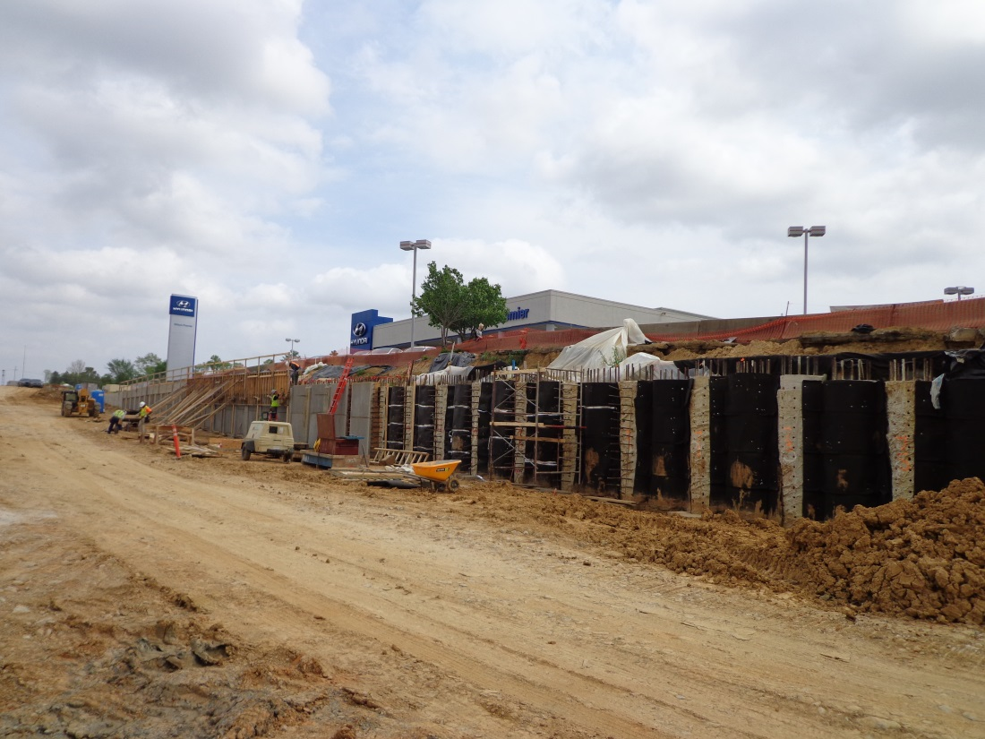
WALL PANEL CONSTRUCTION
(April 10, 2013)

Slide 29
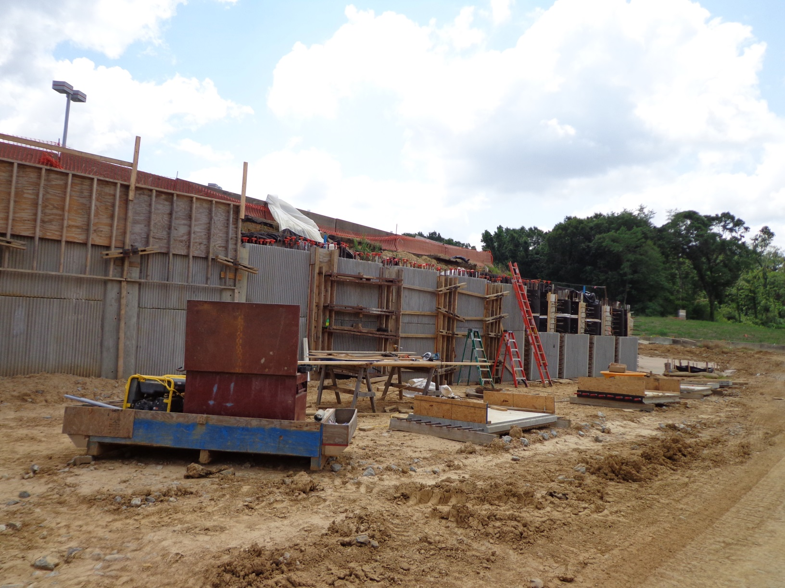
WALL CONSTRUCTION (June 23, 2013)
SHAFT 64
SHAFT 76

Slide 30
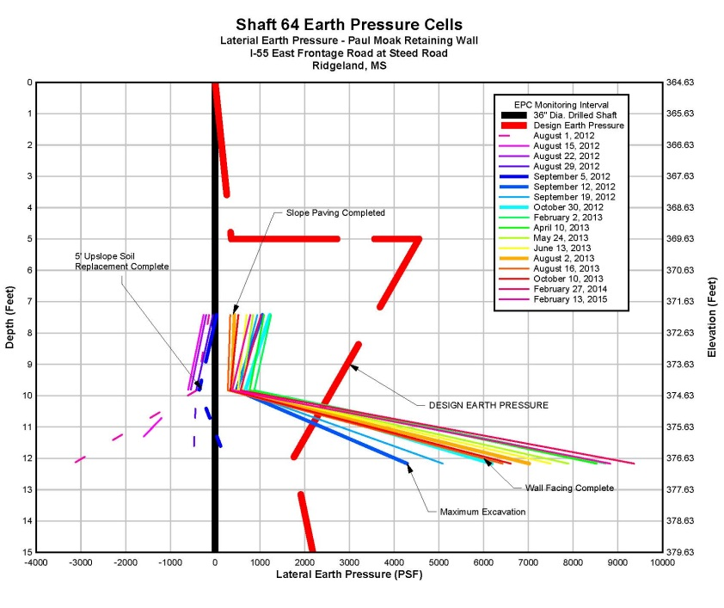

Slide 31
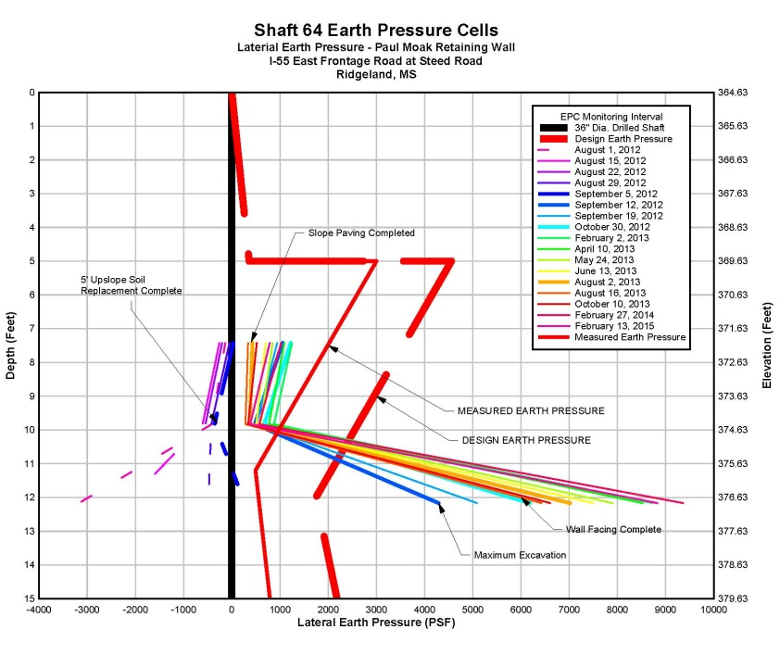

Slide 32
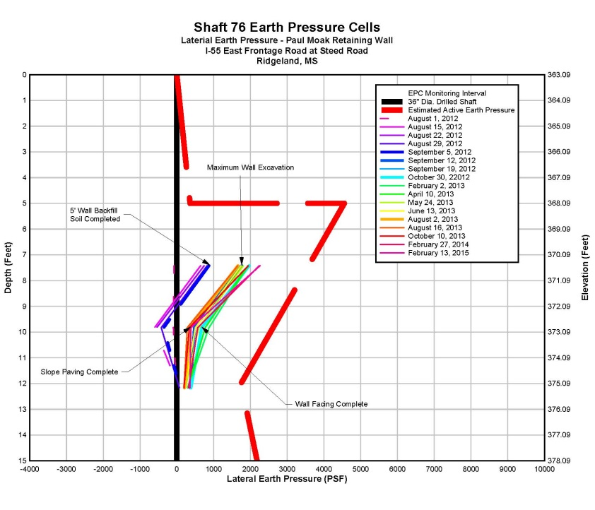

Slide 33
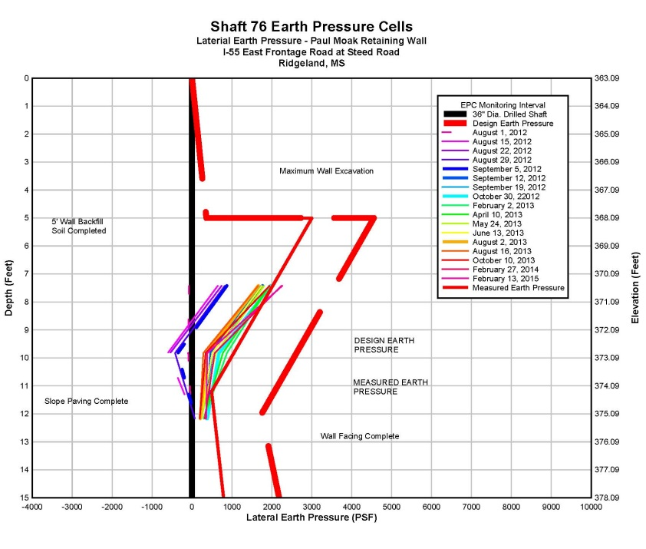

Slide 34
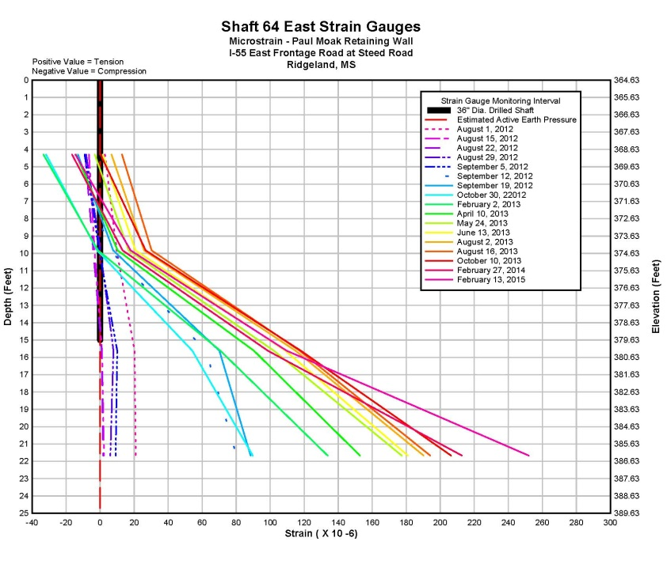

Slide 35
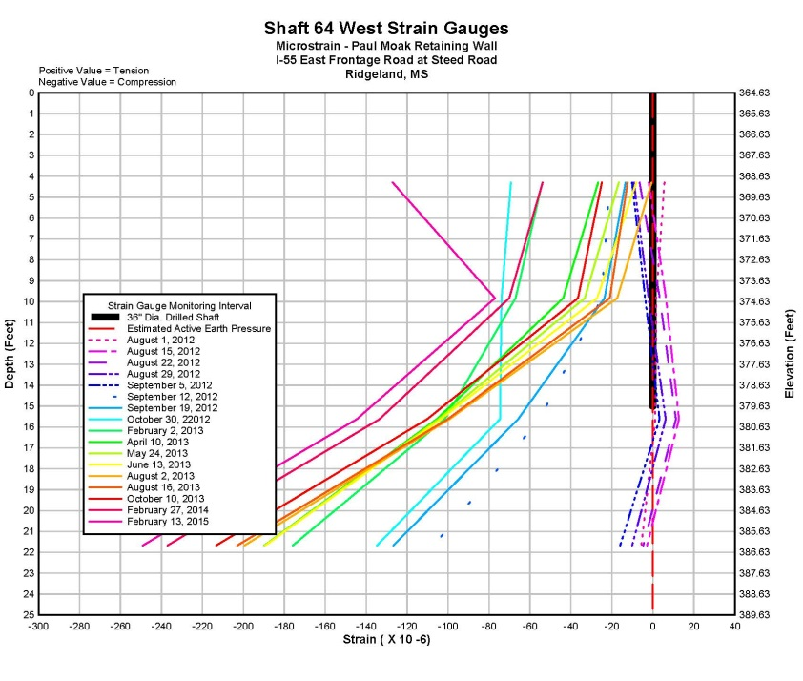

Slide 36
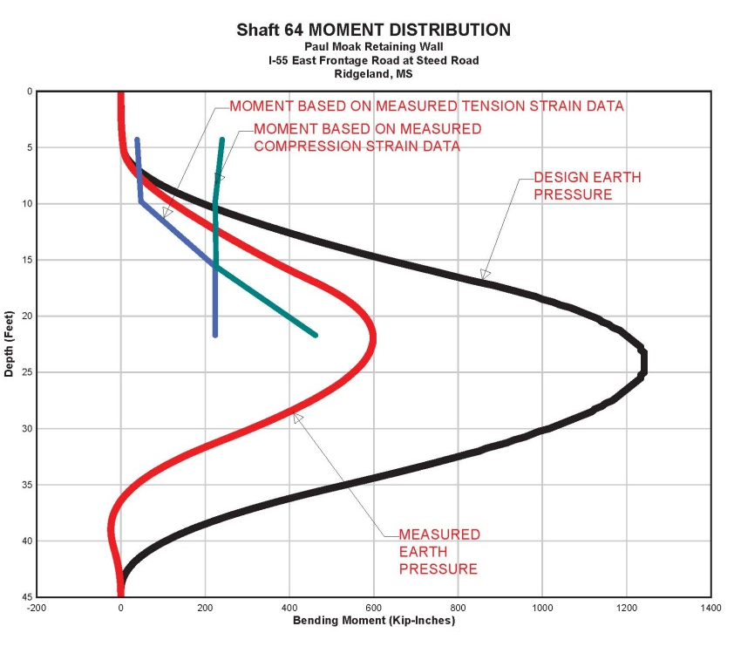

Slide 37


Slide 38


Slide 39


Slide 40


Slide 41

COMPLETED WALL (August 2103)

